Slide 1
Robot Components and Configurations

Slide 2
Robot Components
Power Supply
Actuators
Electric motors
Sensors
Controller

Slide 3
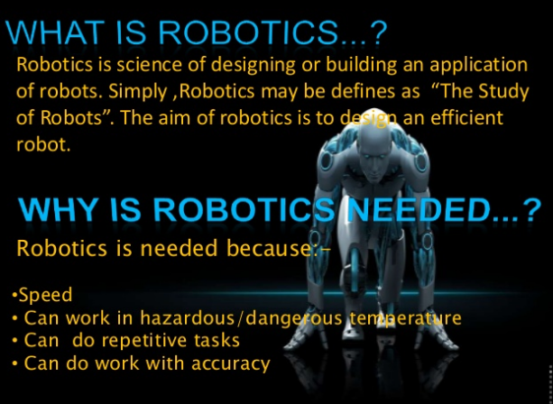

Slide 4
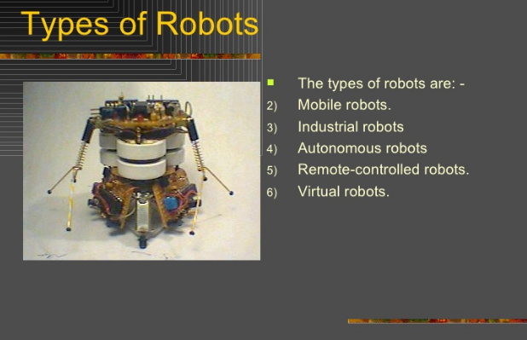

Slide 5
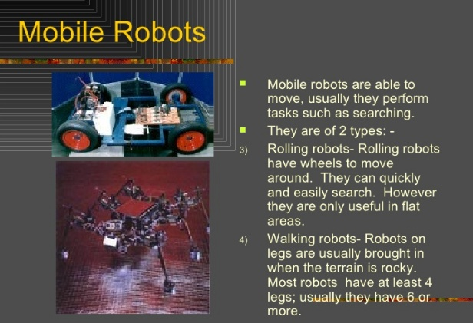

Slide 6
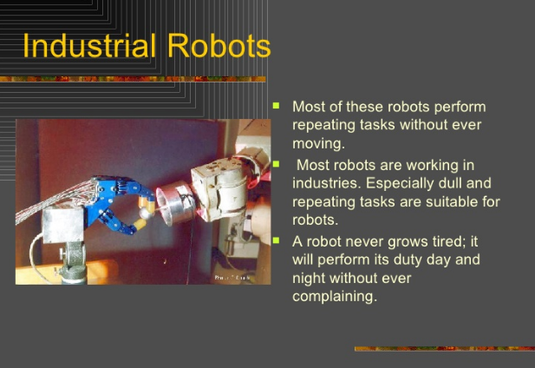

Slide 7
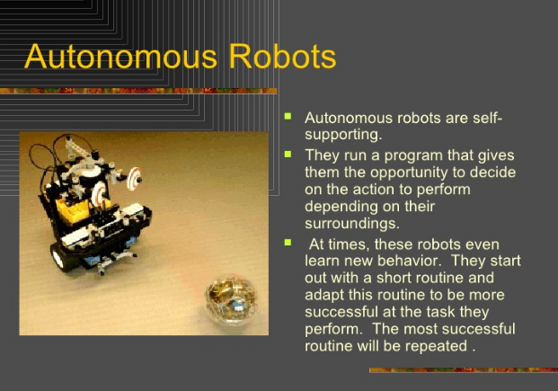

Slide 8
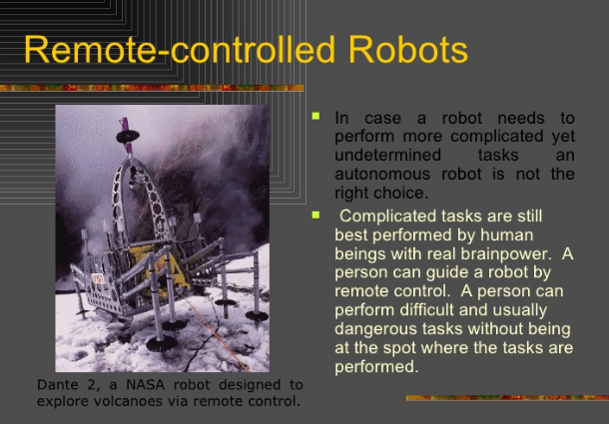

Slide 9
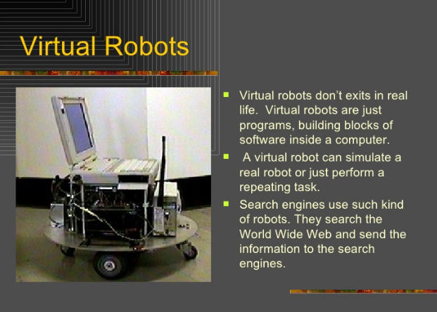

Slide 10
Robot Anatomy
Robot anatomy is concerned with the physical construction of the body, arm, and wrist of the machine.
Most of the robots used in plants today are mounted on base which is fastened to the floor.
The body is attached to the base and arm assembly is attached to the body.
At the end of the arm is wrist.

Slide 11
Robot Anatomy
The wrist of robot consists a number of components that allow it to be oriented in variety of positions.
The body, arm and wrist assembly is sometimes called the manipulator.
Attached to the robot’s wrist or a tool called the “end effector”

Slide 12
Robot Configurations
The industrial robots are available in wide variety of sizes, shapes and physical configurations.
Robot Arm Configurations:
  Cylindrical S
  Spherical/Polar
  Articulated
  SCARA (Selective Compliance Articulated Robot Actuator)

Slide 13
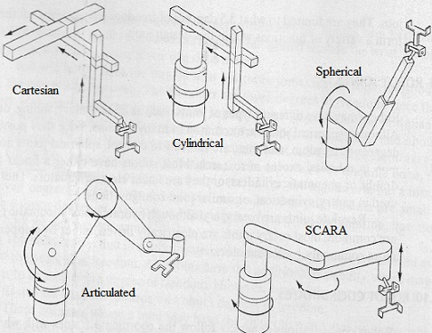

Slide 14
Cartesian
Cartesian robots are perhaps the easiest and least expensive robots to build.
Due to their rigid structure they can manipulate high loads so they are commonly used for pick-and-place operations, machine tool loading, in fact any application that uses a lot of moves in the X,Y,Z planes.
These robots occupy a large space, giving a low ratio of robot size to operating volume. They may require some form of protective covering.

Slide 15
Cylindrical
Cylindrical robots are not widely used today.
They have a rigid structure, giving them the capability to lift heavy loads through a large working envelope, but they are restricted to area close to the vertical base or the floor.
This type of robot is relatively easy to program for loading and unloading of palletized stock, where only the minimum number of moves is required to be programmed.

Slide 16
Articulated Arm
Articulated robots are widely used in industry today. They are very versatile and are the most common robot configuration used in manufacturing industries today.
This is the most widely used arm configuration because of its flexibility in reaching any part of the working envelope.
This configuration flexibility allows such complex applications as spray painting and welding to be implemented successfully.

Slide 17
SCARA
SCARA (Selective Compliance Articulated Robot Actuator) robot configurations are extremely fast and are frequenly used in electronics assembly applications.
Although originally designed specifically for assembly work, these robots are now being used for welding, drilling and soldering operations because of their repeatability and compactness.

Slide 18
Control System
A robot must have a control system which is used to move the arm, wrist, and body of a robot at various paths. When different industrial robots are compared with their control system, they can be divided into four major types.
They are:
Limited Sequence Robots
Playback Robots with Point – Point Control
Playback Robots with Continuous Path Control
Intelligent Robots

Slide 19
Limited Sequence Robots
The limited sequence robots are incorporated with the mechanical stops and limit switches for determining the finishing points of its joints.
These robots do not require any sort of programming. As a result, every joint can only travel to the intense limits.
It is considered as the smallest level of controlling, and it will be best for simple operations like pick & place process.

Slide 20
Playback Robots
The playback robots are capable of performing a task by teaching the position. These positions are stored in the memory, and done frequently by the robot. Generally, these playback robots are employed with a complicated control system.
It can be divided into two important types, namely:
Point to Point control robots
Continuous Path control robots

Slide 21
Playback Robots with Point – Point Control
The point to point robots are shortly called as PTP.
The desired paths are taught and stored in the control unit memory. These robots do not move from the desired location for controlling its path.
It can be moved in a small distance only with the help of programming.
This type of robots can be used for spot welding, loading & unloading, and drilling operations.
Records work cycle as a sequence of points, then plays back the sequence during program execution.

Slide 22
Playback Robots with Continuous Path Control
The continuous path control is also known as CP control.
These robots commonly move in the straight line.
The initial and final point is first described by the programmer, and the control unit defines the individual joints. This helps the robot to travel in a straight line
It can also move in a curved path by moving its arm at the desired points.
Greater memory capacity and capability to execute paths (in addition to points).

Slide 23
Intelligent Robots
The intelligent robots can play back the defined motion, and can also work according to their environment.
The sensor is incorporated in these robots for receiving the information during the process.
This kind of robots is capable of communicating with the programmers in the work volume. It will be best for assembly purposes.

